Slide 1
Sony Pictures Take Home

Slide 2
Agenda
Analysis for General Insights
Trend
Churn
Retention
User-level Metrics Design
User Segmentation
Targeting
Recommendations

Slide 3
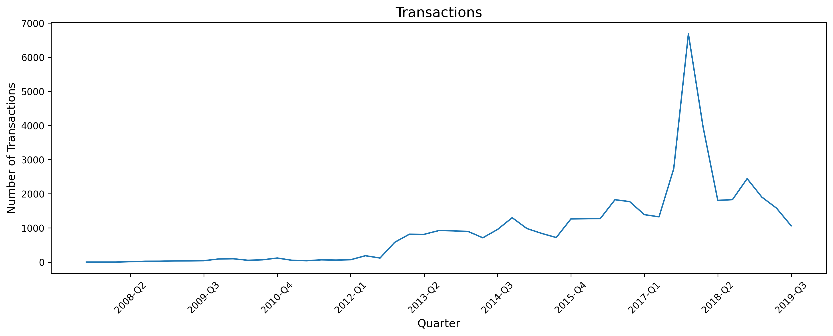
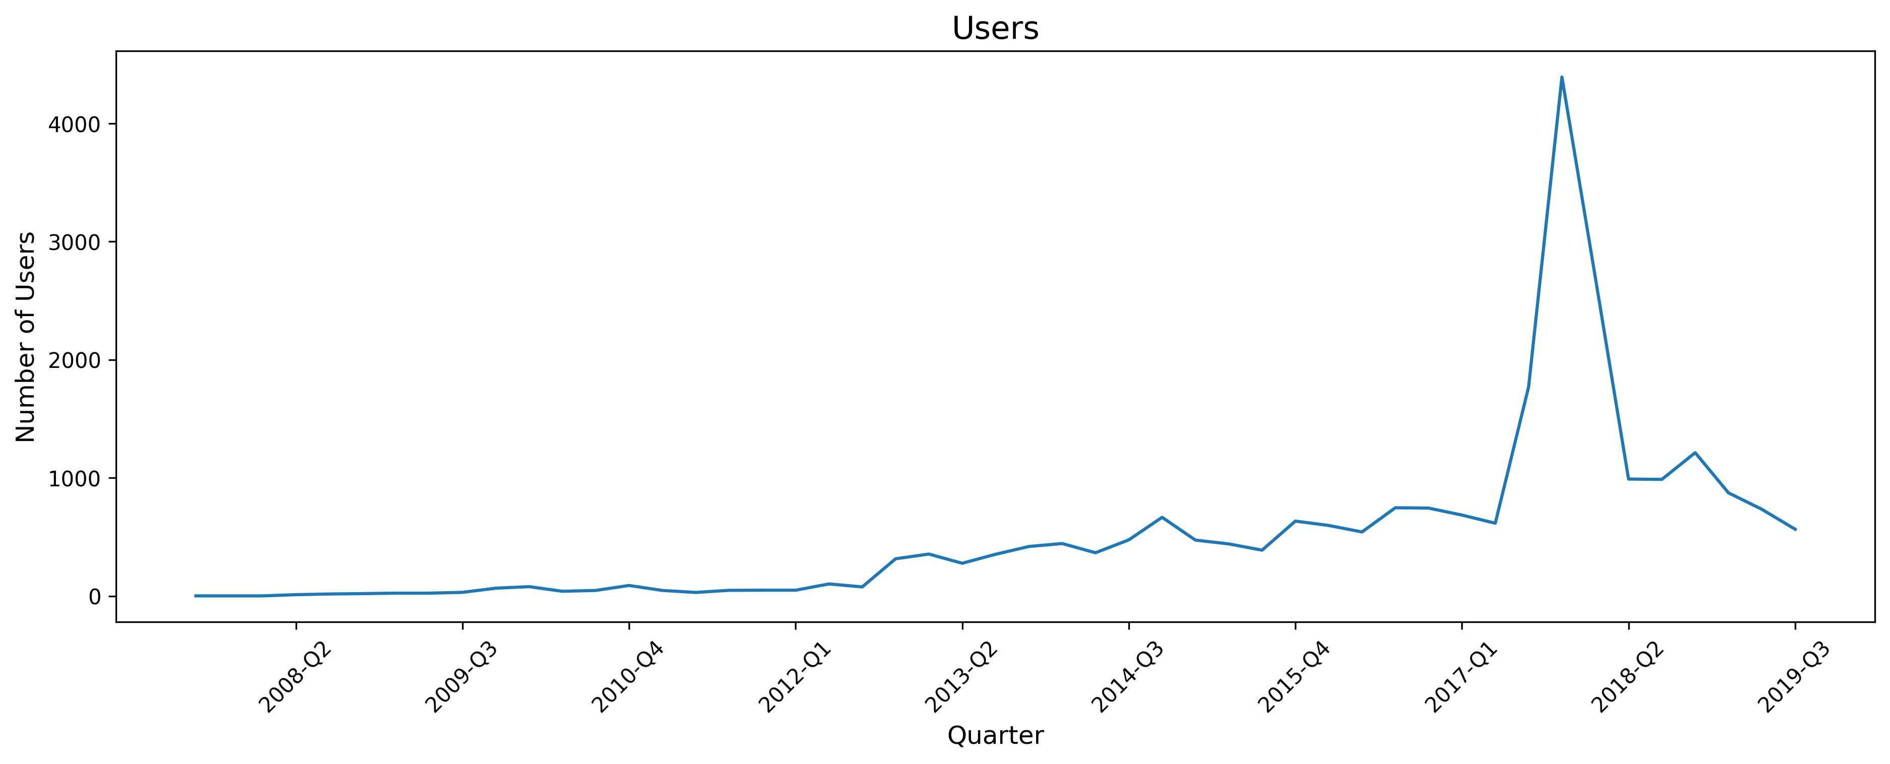
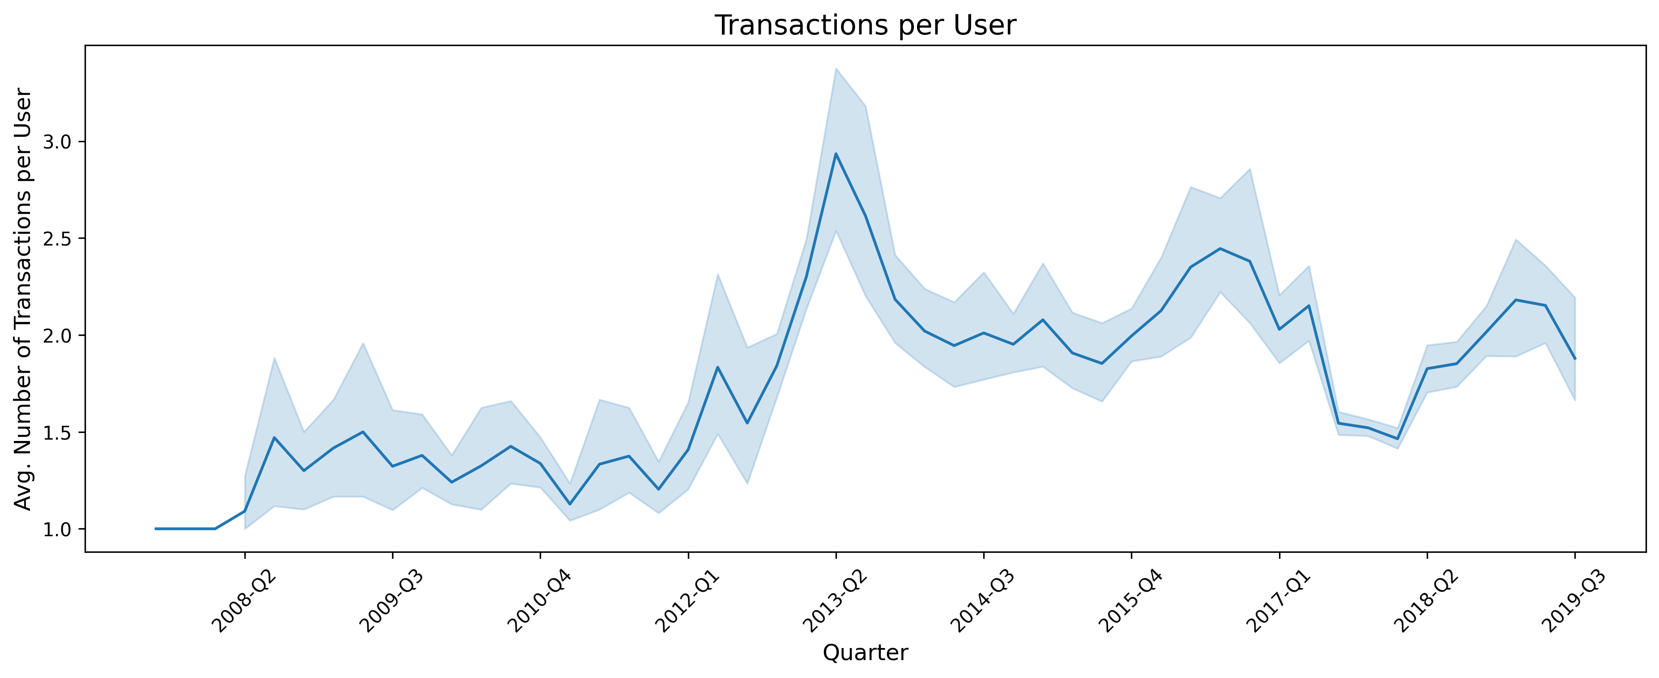
Transactions Trend
Increasing Trend
Low Increase
Steady Increase
Spike
Decreasing Trend
Quick Churn
Churn
User Active Level
Not Following Users & Transactions Trends
Active Between 2013 Q1 and 2017 Q2

Slide 4
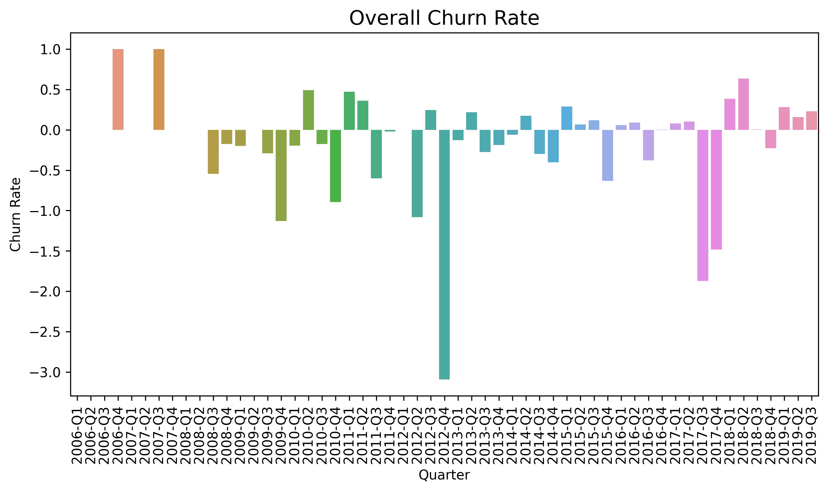
Churn
Phase I (Acquisition)
Before 2012 Q1
Less Than 100 Users (49 Users)
Moderate Increase
Lack Users’ Data
Phase II (Acquisition + Activation)
2012 Q4, First Time Over 300 Users, 3x from 2012 Q3
2017 Q3 1770 Users, 3x from 2017 Q2 (616)
2017 Q4 4393 Users, 2.5x from 2017 Q3 (1770)
Phase III (Churn)
2018 Q1 2700 Users, -1693 Users
2018 Q2 990 Users, -1710 Users
2019 Q3 565 Users

Slide 5
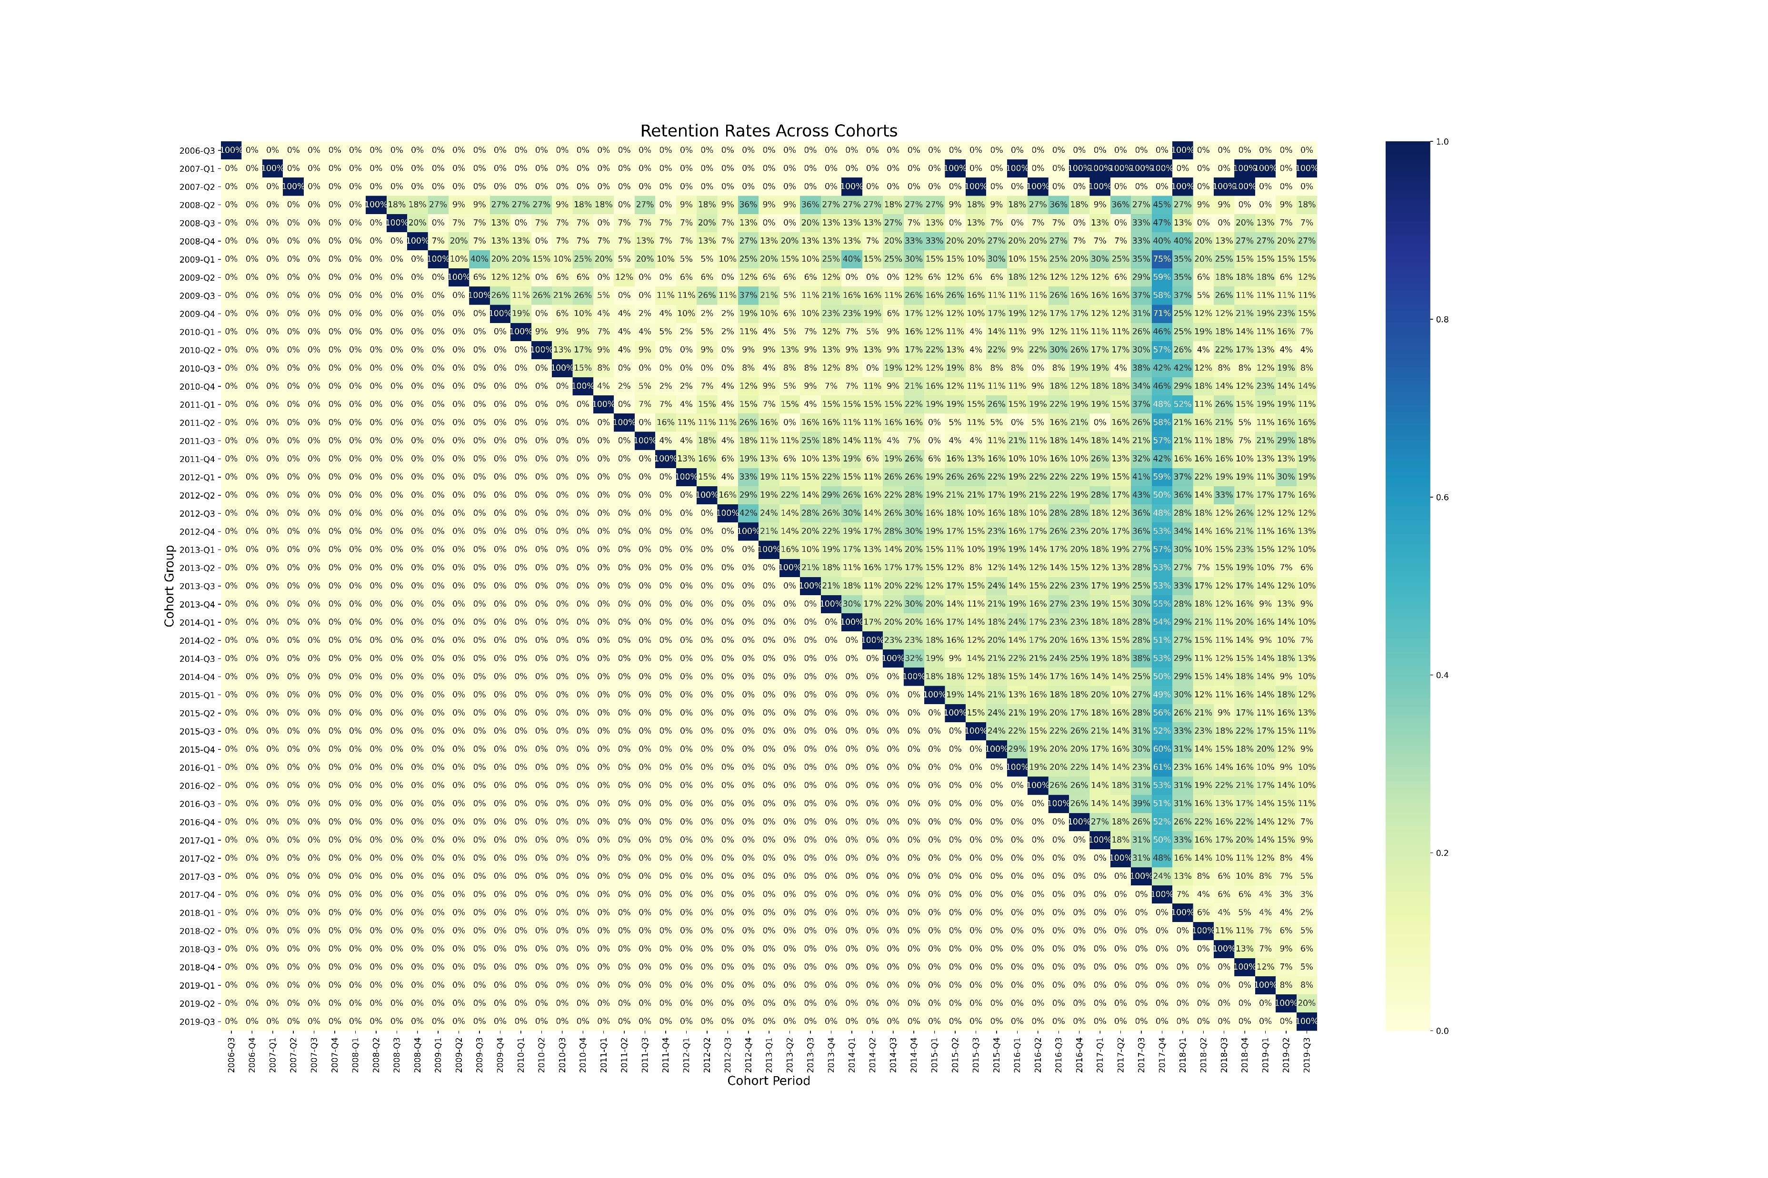
Retention
Most Users Churn After 1st Quarter
Avg. 17.13% 90 Days Retention Rate
The Active Group
Users Could Return After Over 1 Year
The Spike
New Movie Release or Become Available
GhostBusters (2016)：
3417 in 2017 Q4
1839 in 2018 Q1
Spider-Man: Homecoming: 1026 in 2017 Q4
Promotion (Free Movie)
3381 in 2017 Q4
1812 in 2018 Q1
0 in 2018 Q2

Slide 6
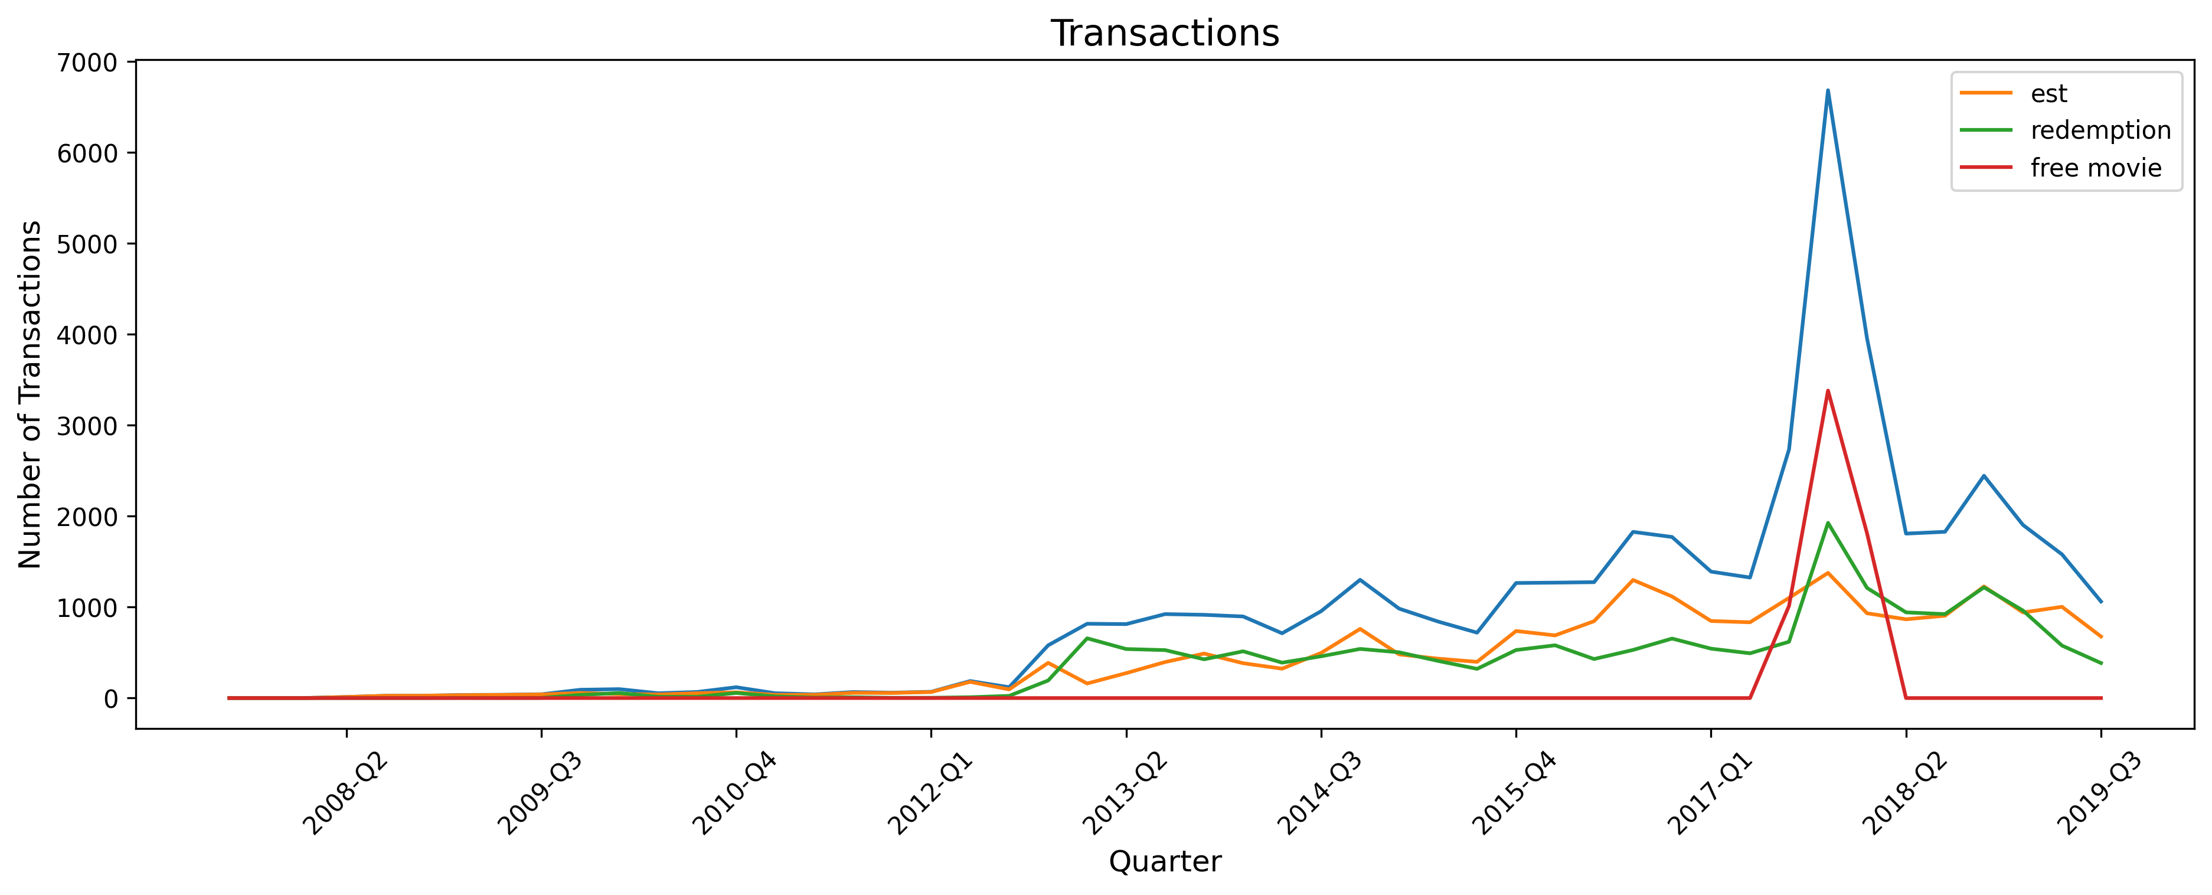
The Spike

Slide 7
User-level Metrics: Transaction
User Journey
Days Between Registration and Today
Number of Transactions
Before Registration
On Registration Date
Within 30 Days of Registration
Between 30 and 60 Days of Registration
Between 60 and 90 Days of Registration
Over 90 Days of Registration
Number of Movies Watched
Days Between Last Transaction and Today (Recency)
Device
Number of Transactions
Andriod
Andriod TV
IOS
PS4
Roku
OS
Web
Kindle
N/A
Transaction Type
Number of Transaction Types
Number of Transactions
Electric Sell-through
Physical Sell-through
Free

Slide 8
User-level Metrics: Product Preference
Genre
Number of Transactions
Comedy
Music
Action
Drama
Classic
Thriller
Sci-fi
Documentary
Romantic
Horror
Children
Family
Crime
Western
Suspense
War
Award Winning
Adventure
Musical
Animation
Biography
Fantasy
Generation
Number of Release Year Ranges
Number of Transactions
Release Year Before 1980
Release Year 1980 - 1989
Release Year 1990 - 1999
Release Year 2000 - 2009
Release Year 2010 - 2019
Crowding
Number of US Boxoffice Ranges
Number of Transactions
Boxoffice Less Than 1 million
Boxoffice 1 – 5 million
Boxoffice 5 – 10 million
Boxoffice 10 – 50 million
Boxoffice 50 – 100 million
Boxoffice Greater Than 100 million
Chasing
Number of Transactions
Within Release Year
1 - 5 Years After Release Year
6 - 10 Years After Release Year
Over 10 Years After Release Year
Repeating
Max Number of Transactions for A Single Movie

Slide 9
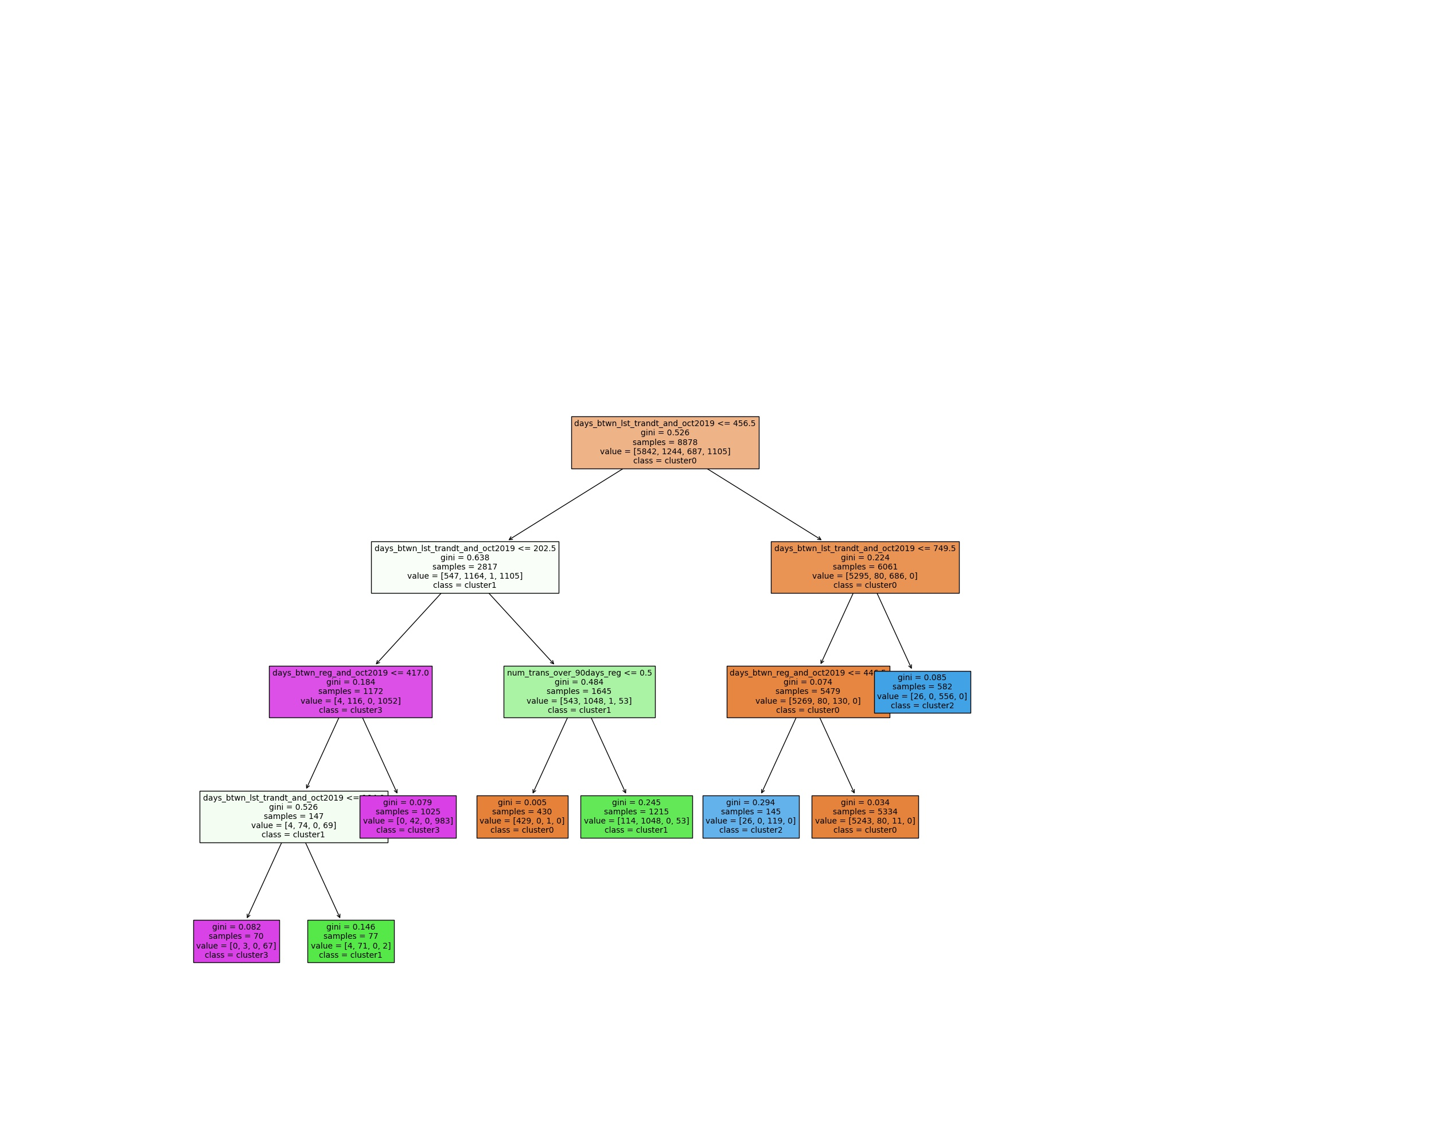
Customer Segmentation
The 4 User Groups:
Highly Active Users (Cluster 3, 1105 Users)
Recency < 104 days + registration < 417 days
Recency < 203 days + registration >= 417 days
Active Users (Cluster 1, 1244 Users)
104 < Recency < 203 days + registration < 417 days
203 < Recency < 457 days + 1+ purchase after 90 days from registration
Inactive Users (Cluster 0, 5842 Users)
203 < Recency < 457 days + 0 purchase after 90 days from registration
457 < Recency < 750 days + registration >= 447 days
Churned Users (Cluster 2, 687 Users)
457 < Recency < 750 days + registration < 447 days
Recency > 750 days
Important factors are Recency, Registration Length, and After-90-days Purchase

Slide 10
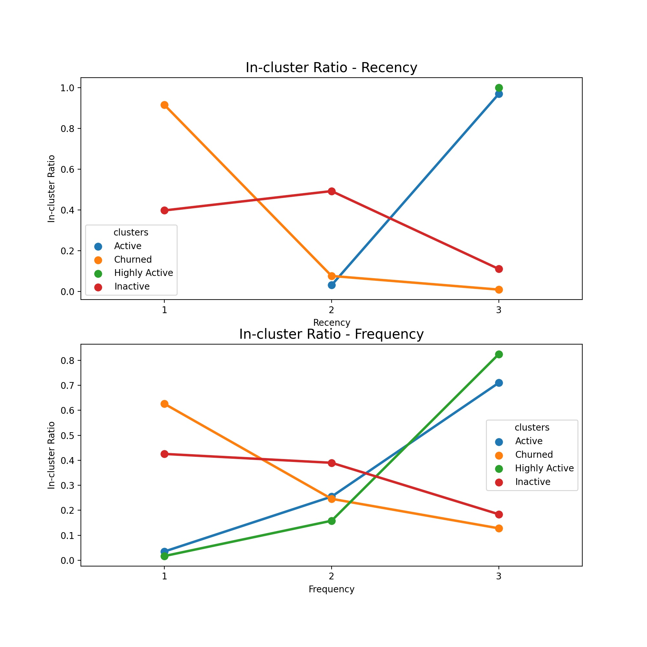
Recency, Frequency
Highly Active Users
All Have Highest Recency Score
Over 80% Users Have Highest Frequency Score
Active Users
Over 90% Users Have Highest Recency Score
All Have Recency Score As 2 Or 3
Over 70% Users Have Highest Frequency Score
Inactive Users
40% and 50% Users Have Frequency Score As 1 and 2, only 10% In 3
40% Users Have Frequency Score As 1 Or 2, 20% In 3
Churned Users
More Than 90% Users Have Lowest Recency
More Than 60% Users Have Lowest Frequency
20% Users Have Highest Frequency

Slide 11
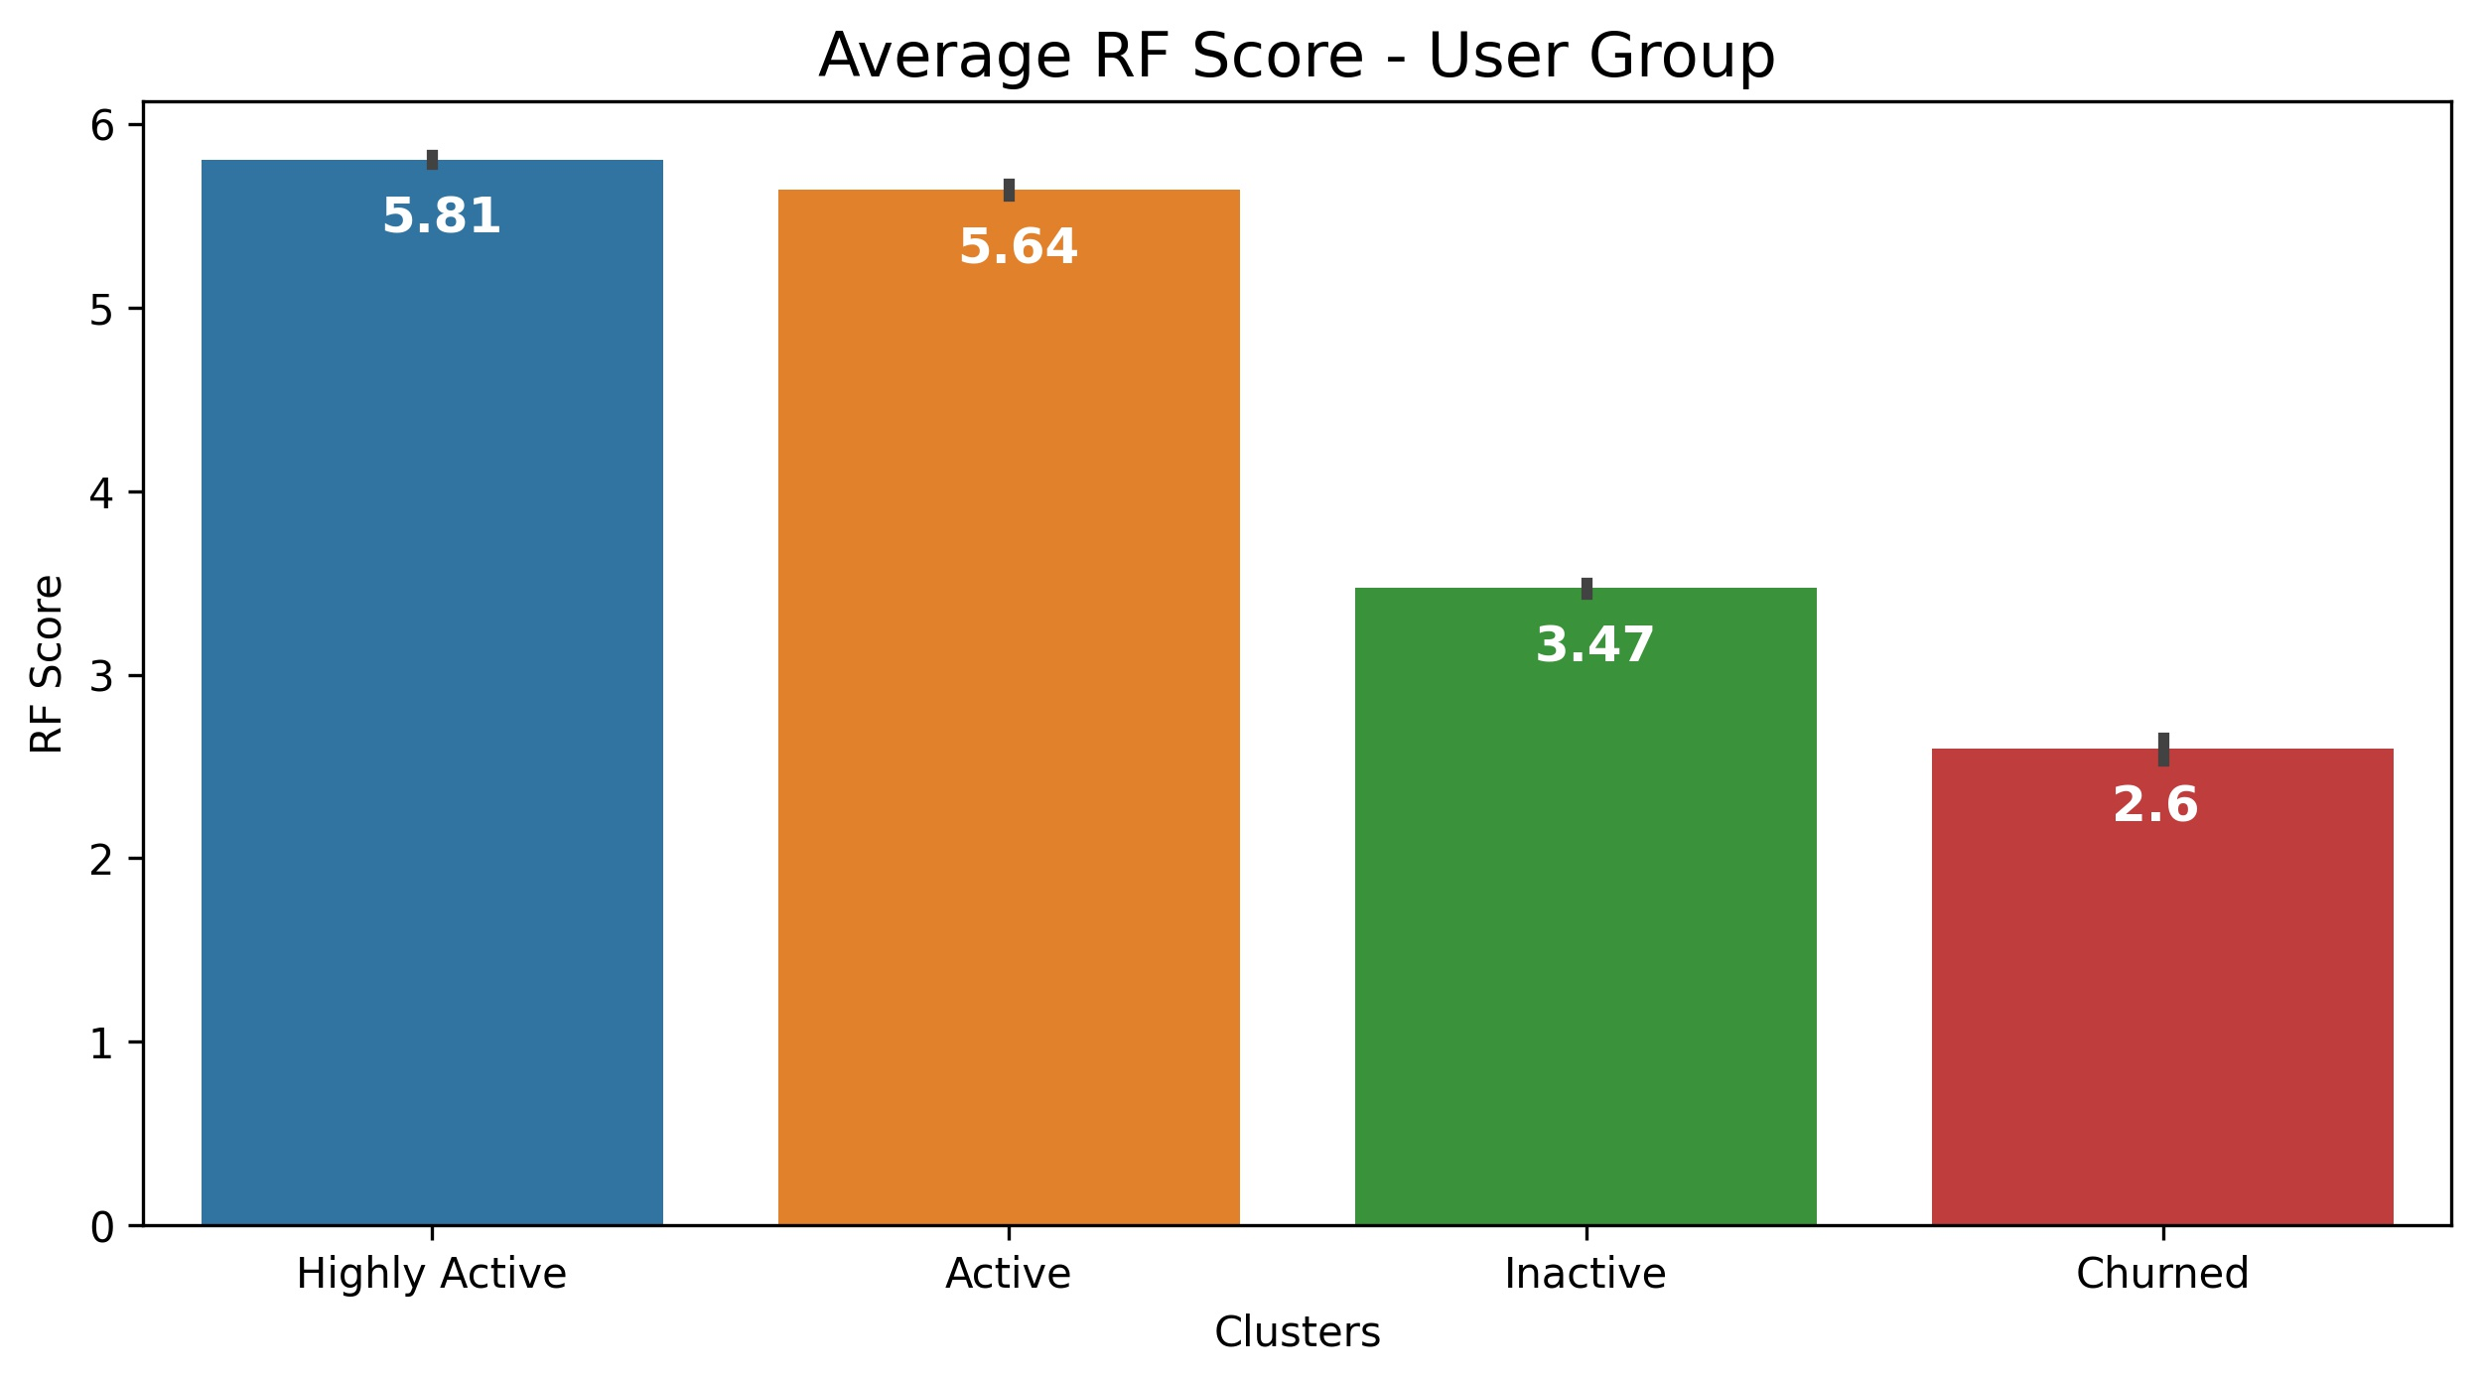
Recency, Frequency

Slide 12
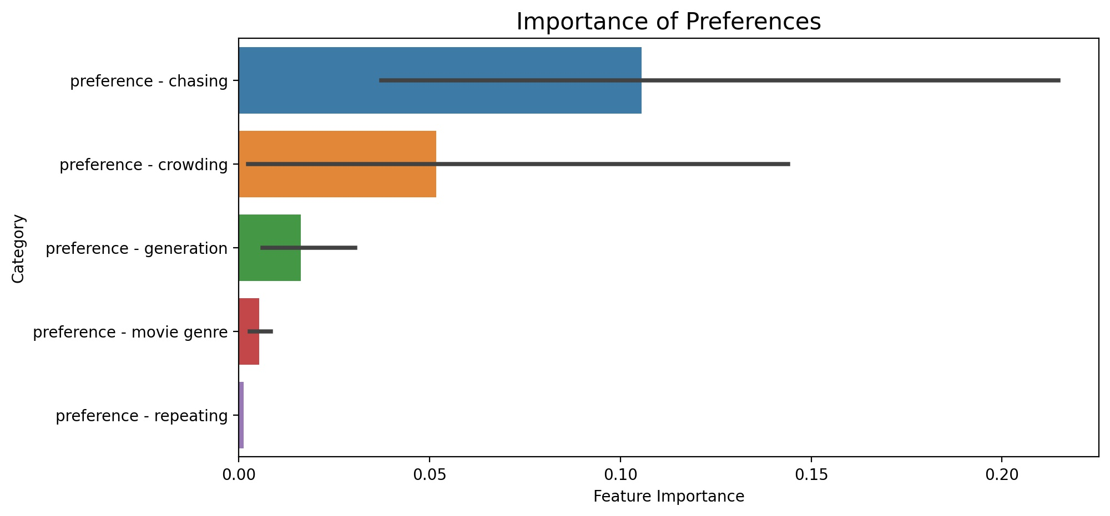
Targeting – Highly Active Users

Slide 13
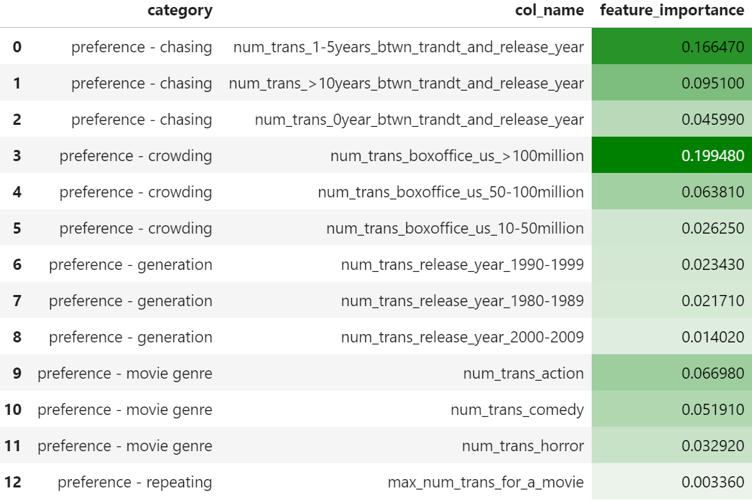
Targeting – Highly Active Users
2
3
Features To Capture Highly Active Users
US Box Office Greater Than 100 Million
1 – 5 Years After Movie Release
Over 10 Years After Movie Release
Actions
Comedies
Movies In The 90’s
1
5
4
6

Slide 14
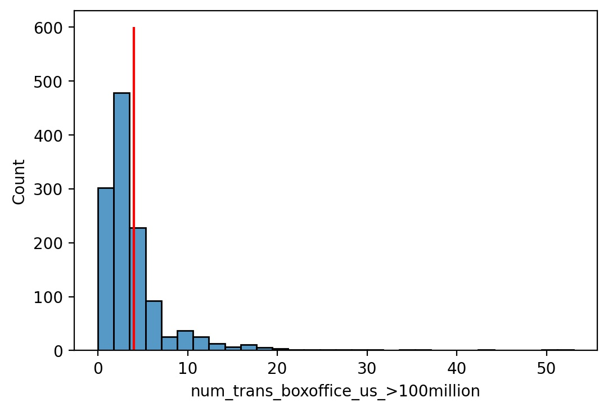
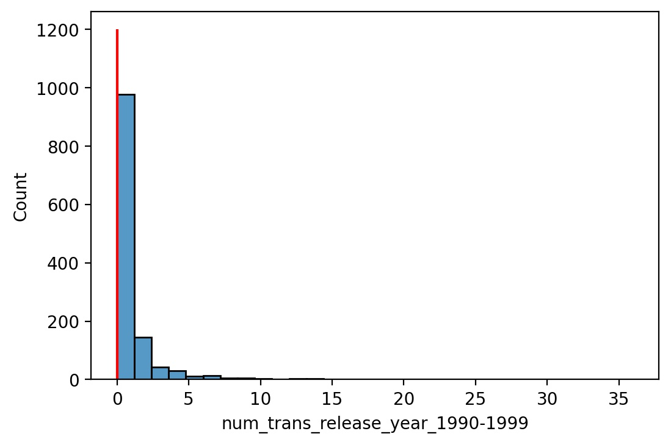

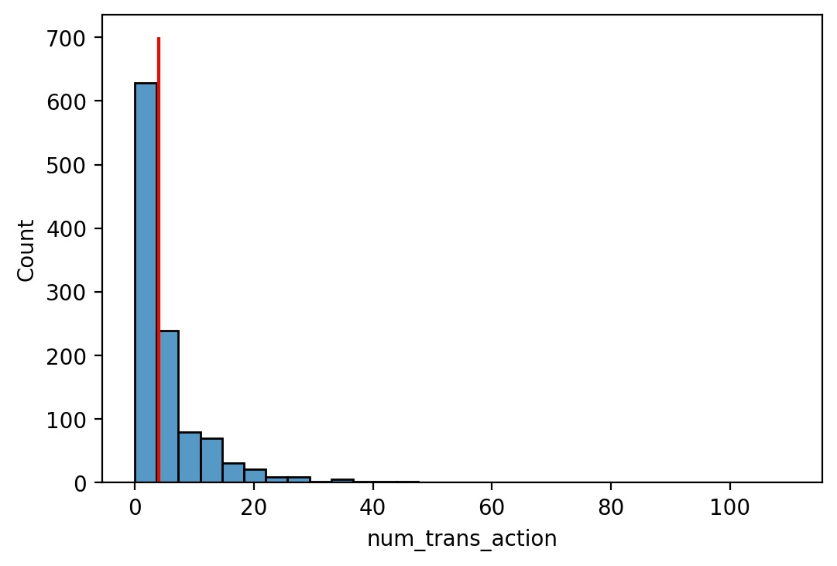
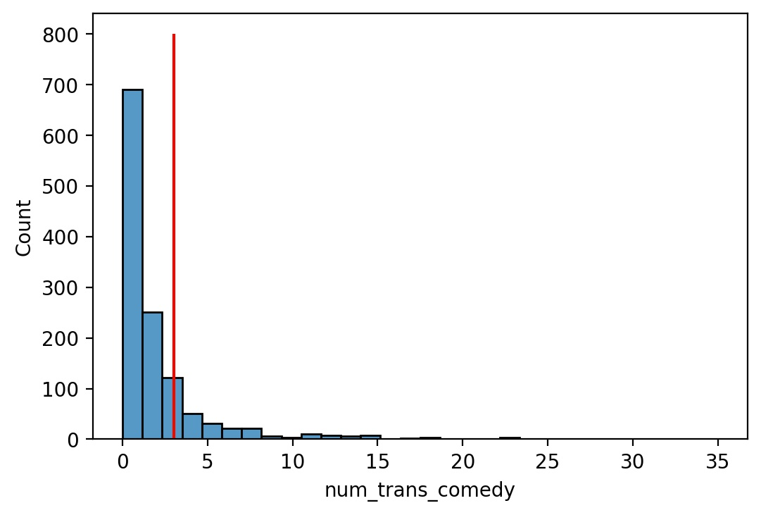
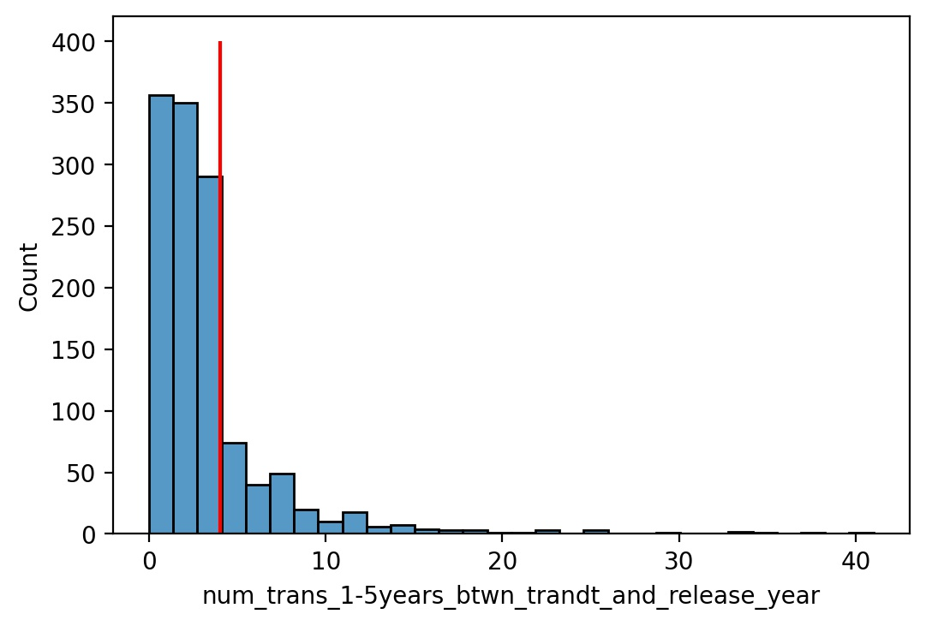
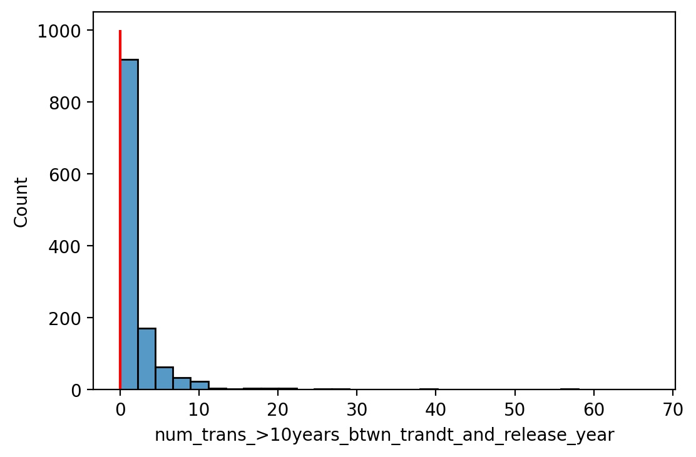
Targeting - Highly Active Users
ID: 1804132
Web User
Registered on Dec 14th, 2017 (656 Days)
Last Purchase is 307 Days Ago
Had 6 Transactions
2 before Registration
1 In 60 – 90 Days After Registration
3 90 Days After Registration
3 Physical Sell-through
2 Electronic Sell-through
3 Comedy, 1 Action, 1 Children, 1 Family
All Release Year 2000 – 2019
4 US Box Office Greater Than 100 Million
4 1-5 Years After Movie Release

Slide 15
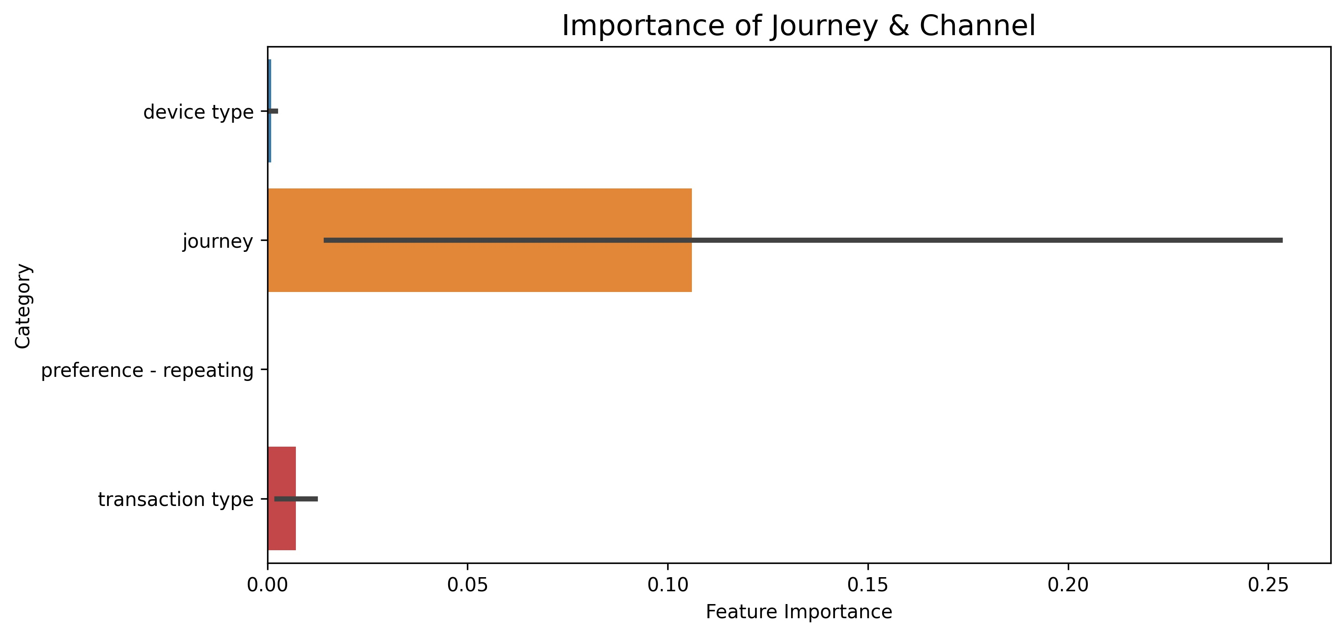
Targeting – Churned Users

Slide 16
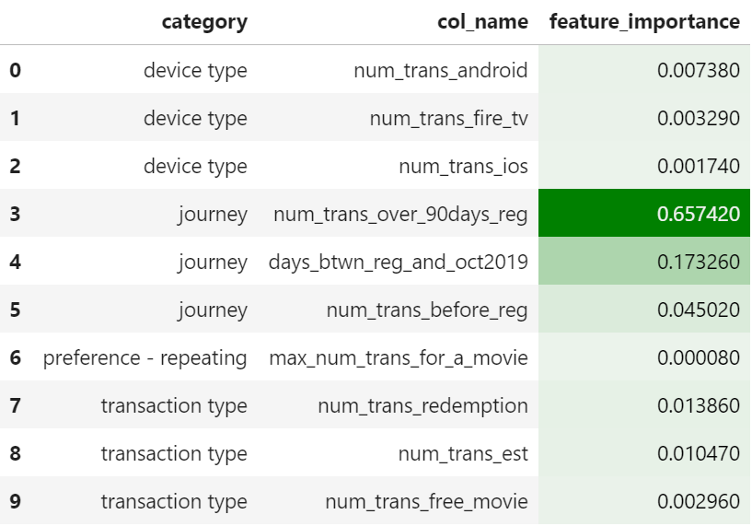
Targeting – Churned Users
6
Features To Capture Churned Users
Transactions After 90 Days of Registration
Length of Being Registered
Transactions Before Registration
Physical Sell-through
Electronic Sell-through
Android (Mobile)
1
2
3
4
5

Slide 17
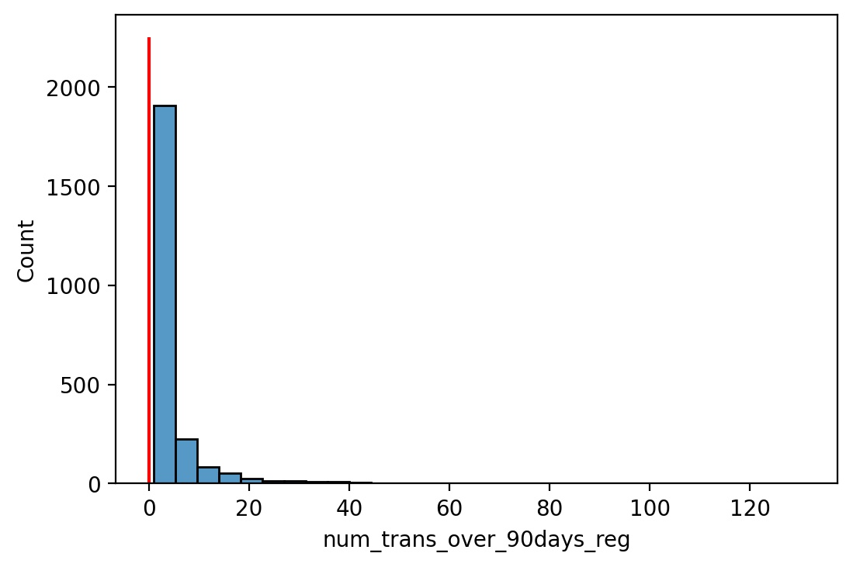
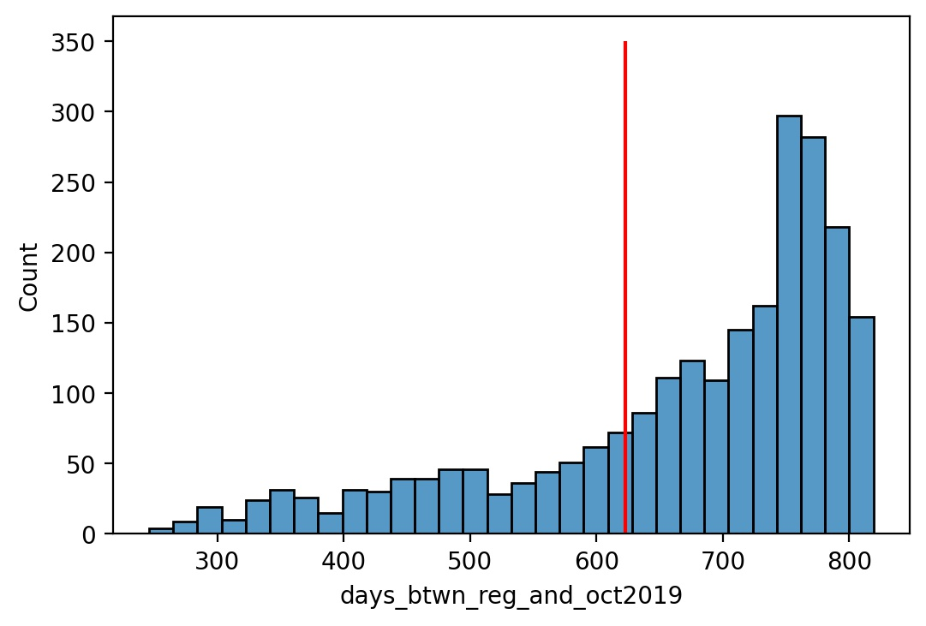

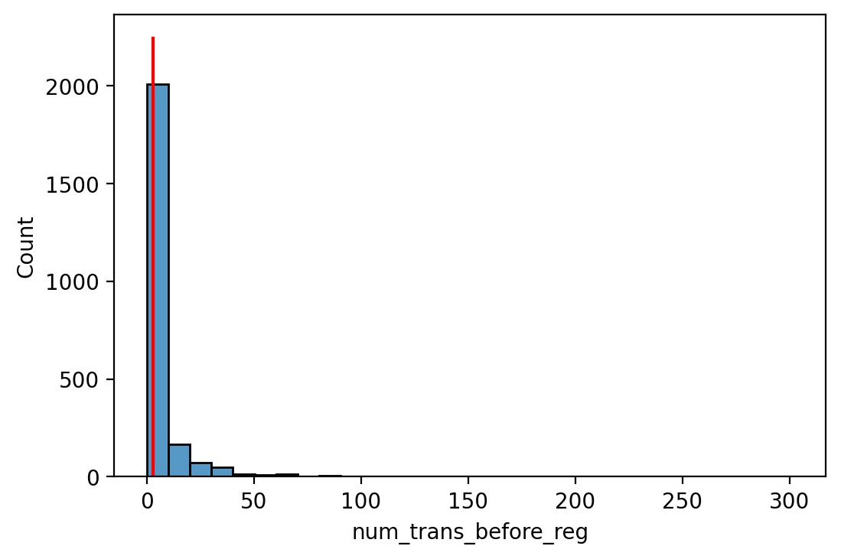
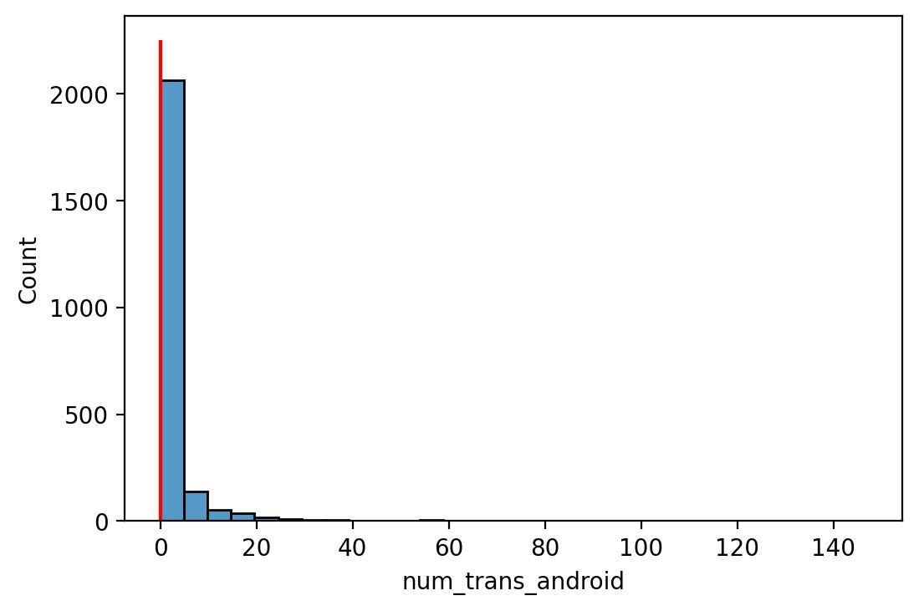
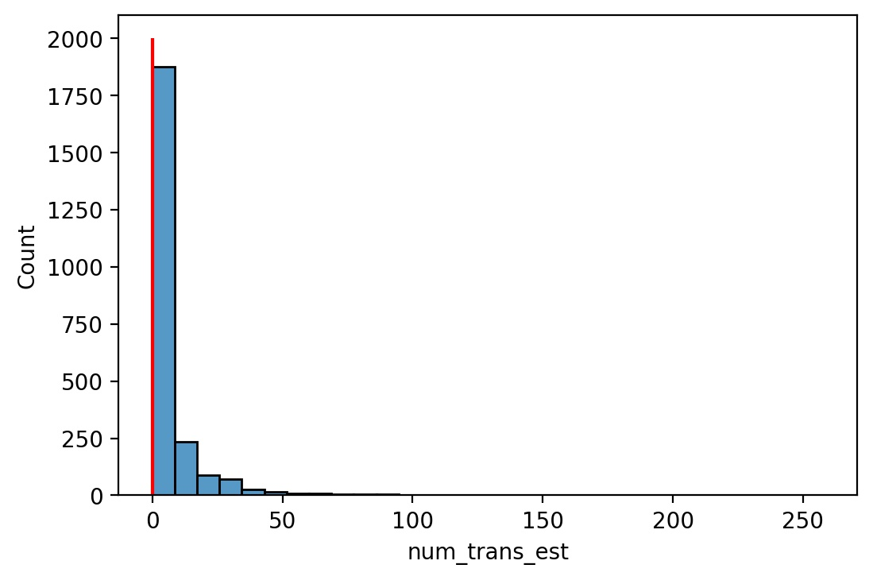
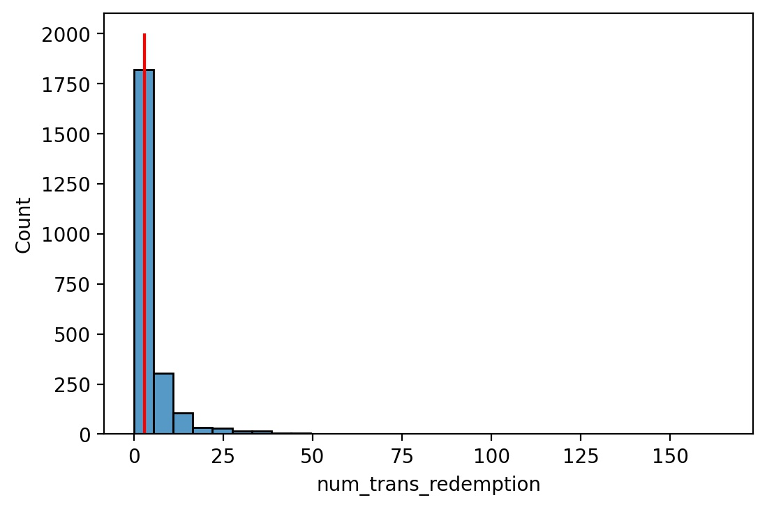
Targeting – Churned Users
ID: 42186522
IOS User
Registered on Jan 16th, 2018 (623 Days)
Last Purchase is 1738 Days Ago
No Purchase After 90 Days Registration
Had 3 Transactions
All before Registration
All Physical Sell-through
1 Action and 2 Family
All Release Year 2010 – 2019
All US Box Office Greater Than 100 Million

Slide 18
Recommendations
Actions to Keep Purchase Recency & Frequency
Post New Released Movie Trailers to Attract Purchase
Post Box Office Updates
Ensure Accessibility of Movies
Proposed Actions on The Preference & Taste:
new releases, e.g. under 5 years
has over 100 million us boxoffice
Actions & Comedies
more variaties of genre
Give Promotions to The Right Group
Ask Feedbacks About Registration Experience Whether It is Helpful

Slide 19
Appendix 1: Basic Data Profile
 | Transactions | Users | Titles
Columns | 'user_id': 'int64' 'title_eidr': 'object' 'transaction_dt': 'object' 'transaction_type': 'object' | 'user_id': 'int64' 'registration_date': 'object' 'dominant_client_type': 'object' | 'title_eidr': 'object' 'title_name': 'object' 'primary_genre': 'object' 'release_year': 'int64' 'boxoffice_us': 'float64' 'rt_critic_score': 'int64'
# Records | 45773 | 8894 | 476
# ids | 45773 | 8879 | 468
# Missing | 0 | 54 ('dominant_client_type') | 0
Dt Column | 'transaction_dt' | 'registration_date' | 'release_year'
From Date | 2006-08-23 | 2017-07-04 | 1939
To Date | 2019-09-26 | 2019-02-14 | 2017
Note 1 | max # transaction/user = 341 | multi-registration | release year = 0
Note 2 | transactions before register | user id negative | genre not exclusive

Slide 20
Appendix 2. Data Quality
1. Change Data Type
'transaction_dt’ ➔ 'datetime64[ns]’
'registration_date’ ➔ 'datetime64[ns]’
2. Sort Tables
Transactions: 'user_id', 'transaction_dt’
Users: 'user_id’
Titles: 'title_eidr’
3. Impute Missing Values
'dominant_client_type’ ➔ NA (not available)
4. Adjust Values in Tables
Users: 'user_id’ ➔ reverse value
Titles: 'release_year’ ➔ select the release year of the 1st version of the movie
5. Make Id Primary
Users: select the earliest 'registration_date’ as the registration date
Titles: select values of the 1st version of the movie

Slide 21
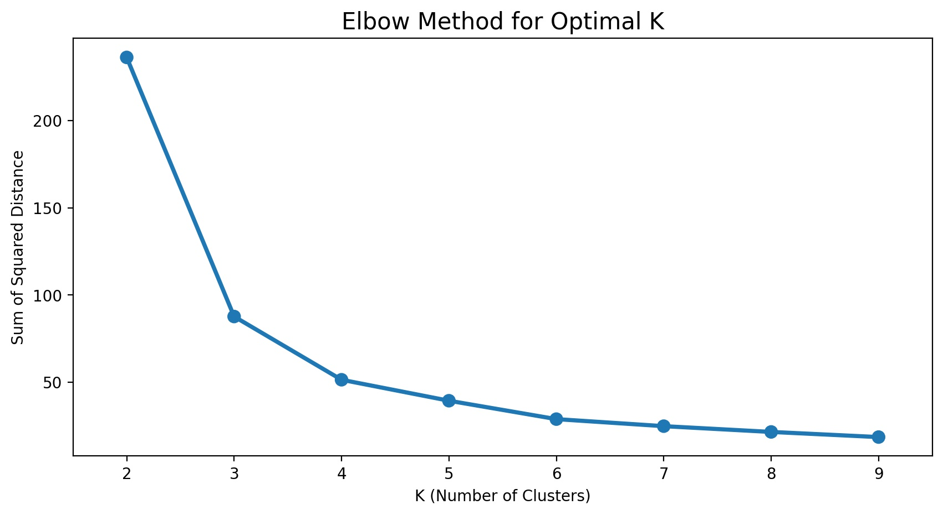
Appendix 3. Elbow Method for K

Slide 22
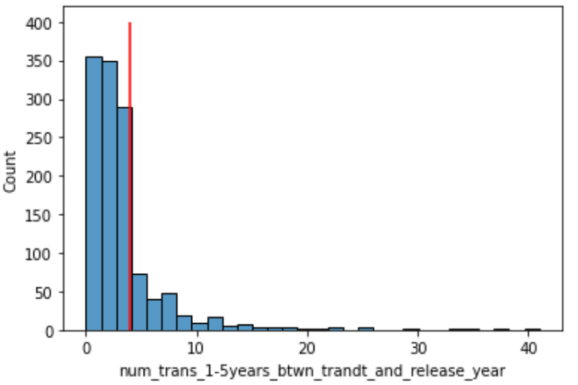
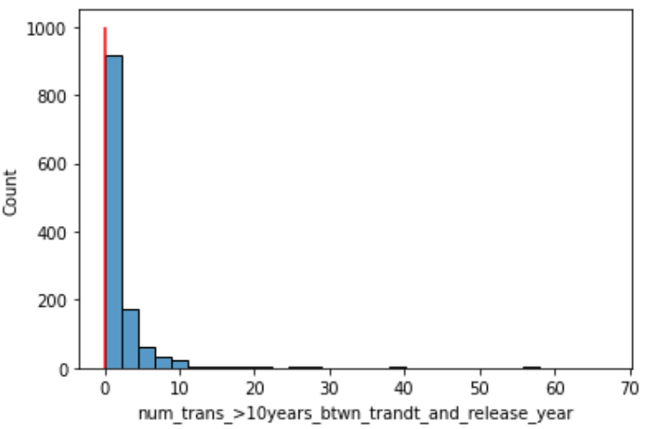
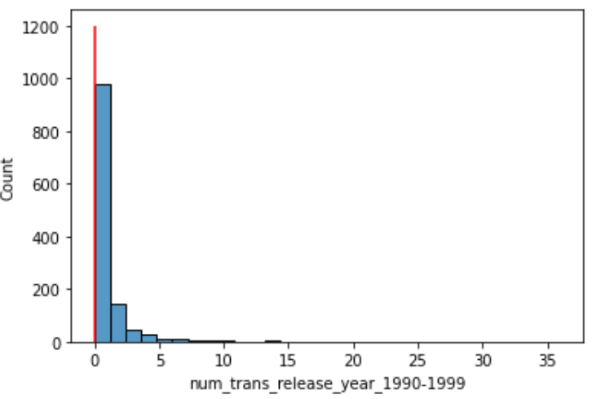
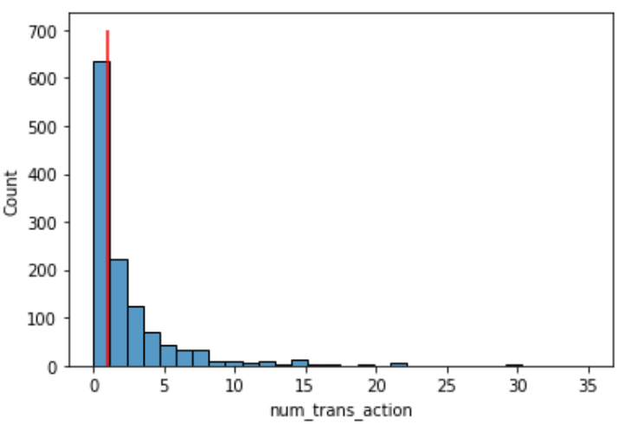
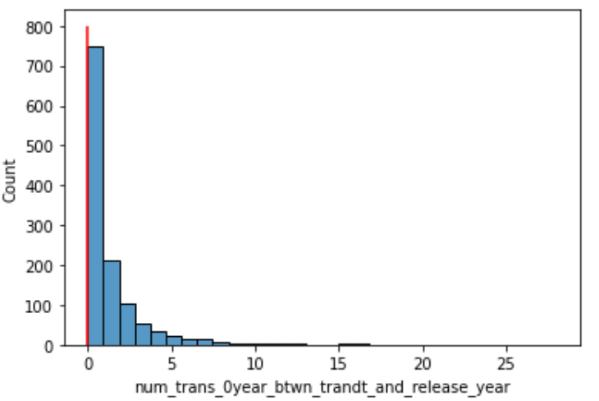
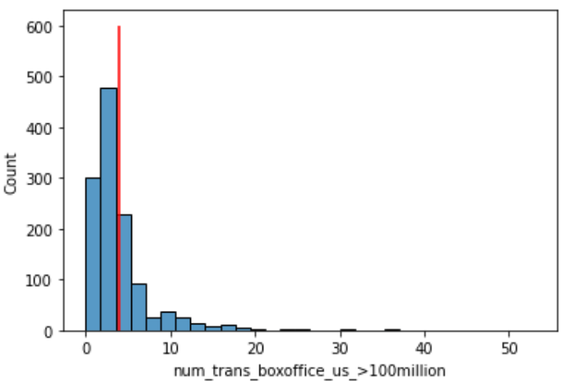
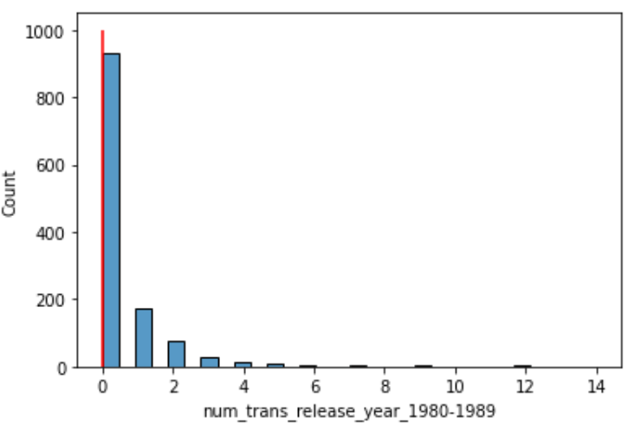
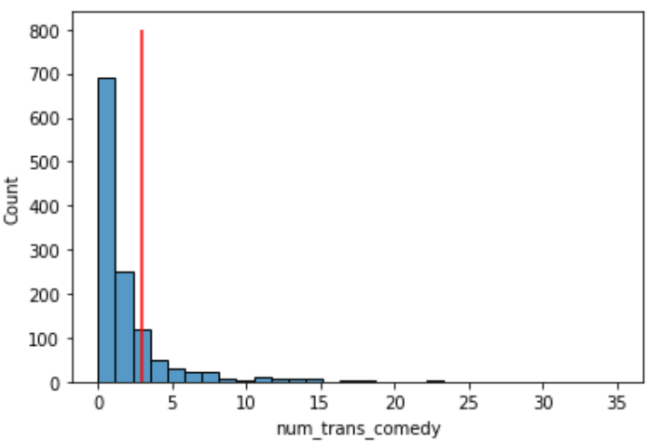
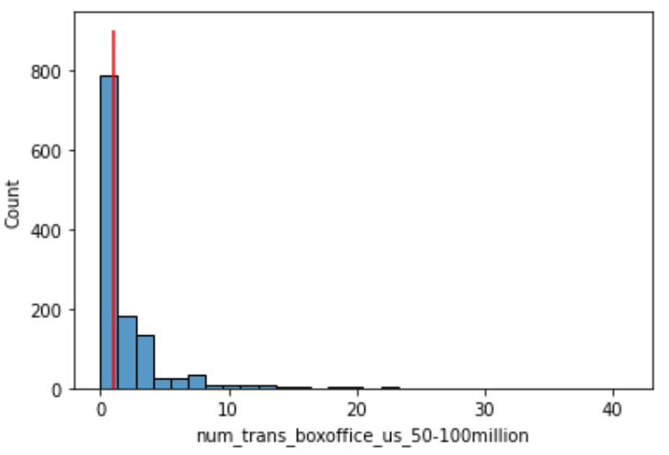
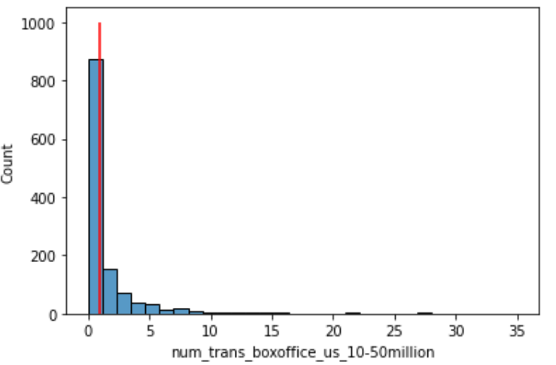
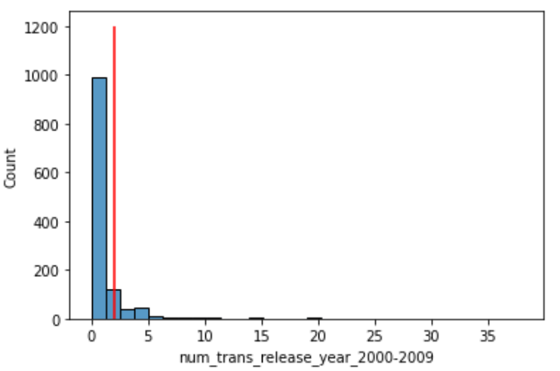
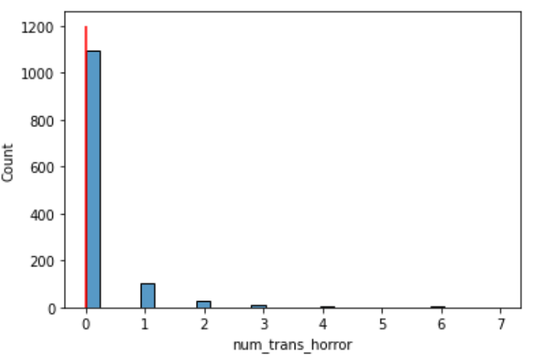
Appendix 4. Highly Active Users Preference Lookalike

